Slide 1

Image Compression for Intelligent Mobile Devices
- Zhihan Liu, 1730784

Slide 2
Table of contents
01
02
03
04
05
06
Introduction
Scenario
Pipeline
Background, Objectives and Core Techniques
Simulate a real requirements scenario
Compression and decompression pipelines
Quantitative
Entropy Coding
Assessment
Comparison and selection of quantitative methods
Comparison and selection of entropy coding methods
Compression Testing and Image Quality Assessment (IQA)

Slide 3
Introduction
01
Image Compression for Intelligent Mobile Devices

Slide 4
Background and Challenges
Smart devices (e.g., smartphones, drones, dashcams) often capture high-resolution images or videos. Storage capacity and network bandwidth limitations, especially in real-time transmission, demand efficient compression methods.
Objective
Develop a lossy image compression algorithm based on human eye perception to achieve visually lossless, flexible and efficient compression.

Slide 5
Core Techniques
Effectively compresses long repetitive sequences in the low-frequency chrominance regions after FMM quantization.
Exploits the human visual system's non-uniform sensitivity to spatial frequencies, preserving critical details while discarding less noticeable information.
Entropy Coding
(Run-Length Encoding, RLE)
Perceptual Coding
FMQM Quantization
Advantages
The combination of FMQM quantization and RLE greatly reduces data entropy, while simplifying encoding and decoding processes. Suitable for real-time applications in resource-constrained devices like drones.
Uses adjustable modulus values to perform controllable lossy compression, achieving a balance between image quality and compression rate.

Slide 6

Perceptual Coding
By taking advantage of the human eye's varying sensitivity to different frequencies, compression algorithms can discard more information in less sensitive regions while retaining higher fidelity in critical areas.
Color space conversion
Convert an image from RGB color space to YCbCr color space.
Highly sensitive to luminance (Y channel) changes, especially edges and high-frequency details.
Less sensitive to chrominance (Cb and Cr channels) changes, particularly in low-frequency regions.

Slide 7
02
Scenario
Image Compression for Intelligent Mobile Devices

Slide 8



Assume a wildlife protection monitoring system, in which multiple drones are used to capture images of wildlife and transmit them to a central monitoring station in real time.
Constraints
Image Resolution: Use high-resolution images to facilitate better wildlife observation.
Network Bandwidth: The average bandwidth in cities is usually between 10~50 Mbps, taking the lowest bandwidth of 10 Mbps.
Transmission Delay: Each image must transmit within 2 seconds for real-time monitoring.
Storage Space: Limited local storage requires high compression rates to maximize data storage.
Quality: Maintain PSNR ≥ 30 dB and SSIM ≥ 0.95 to preserve important image details for research.
Must be achieved
Use images with a resolution of ≥ 1920×1080.
The compression ratio must be at least 50%.
The compressed image transmission bit rate must be ≤ 2 Mbps.
The image transmission time must be ≤ 2 seconds at 10 Mbps bandwidth.
The compressed image must have a PSNR of ≥ 30 dB and a SSIM of ≥ 0.95

Slide 9
Pipeline
03
Image Compression for Intelligent Mobile Devices

Slide 10
Encoding Pipeline
Calculate the entropy of the original .raw image as a measure of data complexity
Read .ppm file, extract binary data, save to .raw format
2. Calculate Entropy
1. Extract Raw Data
3. RGB to YCbCr
Based on FMM quantization parameters can be dynamically adjusted based on image channels.
Convert to YCbCr, separate luminance (Y) and chrominance (Cb, Cr) channels
4. Quantization
5. Recalculate Entropy
Calculate the entropy of the 3 channels after FMM quantization
Use RLE (Run-Length Encoding) to effectively compress repetitive data segments
Save RLE-encoded data as a binary file, storing relevant data
6. Entropy Coding
7. Encoded Data

Slide 11


Decoding Pipeline
Generate the decompressed image and save it in a common format
Restore RLE-encoded binary data to original data
2. Decoding
4. Output Image
1. Encoded Data
3. YCbCr to RGB
5. Image Quality Assessment
Read the binary file saved after image compression
Convert restored YCbCr data back to RGB color space
Image quality assessment using PSNR and SSIM methods

Slide 12
04
Quantitative
Image Compression for Intelligent Mobile Devices

Slide 13
Different Methods
Uniform Quantization
Non-Uniform Quantization
The continuous signal is divided into fixed steps, with each step mapped to a single value.
Adjusts interval width based on data, using finer quantization for important areas.
Disadvantage
Non-uniform data distribution can distort high-frequency areas or important details, affecting visual quality.
Disadvantage
High complexity and requires pre-analysis of data distribution.
Vector Quantization
Prediction
Divides data into dimensions, maps to the nearest codeword index.
By predicting the current pixel value (e.g. based on neighbor), only the prediction error is stored, and the error is quantized.
Disadvantage
Complex encoding/decoding and requires a codebook, increasing initial calculations.
Disadvantage
Prone to error accumulation and requires complex step-by-step decoding.

Slide 14
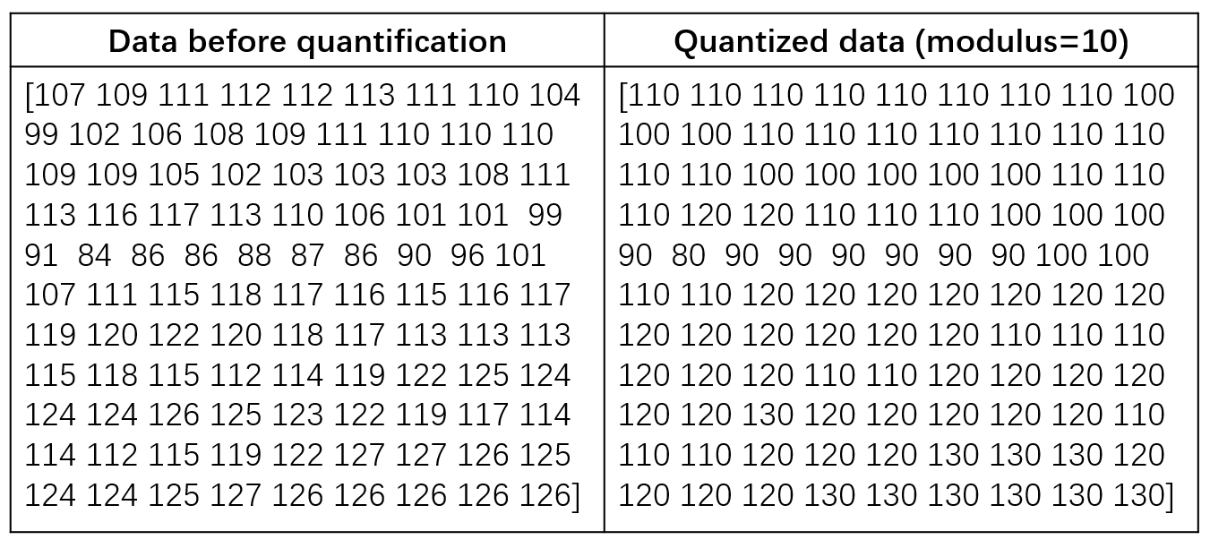
FMQM —— Quantization Method
Based on FMM
Simpler and more flexible. Freely set modulus by different channels.
Channel Division
The image is divided into three channels:
- Y (Luminance)
- Cb (Chrominance Blue)
- Cr (Chrominance Red)
Quantization Approach
Combines FMM Quantization and Uniform Quantization ideas:
- Divide the original value by a specified modulus.
- Round the result.
- Multiply it back by the modulus.
Modulu = 5
143 / 5 * 5
=
145
=
147 / 5 * 5
143 / 5 =
28.6 ≈ 29
FMM
The FMM method consists of converting each pixel value in an 8-by-8 block into a multiple of 5 for each of the R, G and B arrays. After that, the new values could be divided by 5 to get new values which are 6-bit length for each pixel, and it is less in storage space than the original value which is 8-bits.
147 / 5 =
29.4 ≈ 29

Slide 15
More Suitable for Projects
Preservation of Visual Details
Dynamic Adjustment
Computational Efficiency
By selecting appropriate modulus values, the method significantly reduces data storage and transmission while retaining critical visual information in the image.
Modulus values can be dynamically adjusted based on the complexity of the image, providing greater flexibility to meet the compression needs of different scenarios.
With a time, complexity of O(n), the algorithm is highly efficient, making it suitable for processing large-scale image data and real-time applications in resource-constrained devices, such as drones.

Slide 16
Entropy Coding
05
Image Compression for Intelligent Mobile Devices

Slide 17

Different Methods
Huffman Coding
Arithmetic Coding
Golomb Coding
Assign shorter codewords to more frequent characters based on their occurrence probability.
Encode the data by mapping it to a decimal within a range and narrowing the range progressively.
Data is split into quotient and remainder; quotient uses Unary encoding; remainder is encoded based on factor m.
Disadvantage
Requires extra storage for dynamic code tables.
Encoding and decoding are more complex.
Disadvantage
Requires extra storage for the probability model.
High computational complexity.
Disadvantage
Ineffective for non-geometric data.
Unary encoding of large quotients may cause redundancy.

Slide 18
Why Choose RLE ?
Efficient Collaboration with Quantization
Low Computational Complexity
1
2
After quantization method based on FMM, the 3 channels (Y, Cb, Cr) contain long sequences of identical values, which RLE efficiently compresses to reduce file size.
RLE encoding and decoding are simple and require minimal computational resources, making it ideal for intelligent mobile devices like drones.
Real-Time Performance
Simplified Decoding Process
3
4
RLE operates at high speed during both encoding and decoding, making it a simpler alternative to Huffman or other entropy coding.
RLE decoding avoids complex models or dictionaries, making it ideal for efficient decoding scenarios.

Slide 19
06
Assessment
Image Compression for Intelligent Mobile Devices

Slide 20
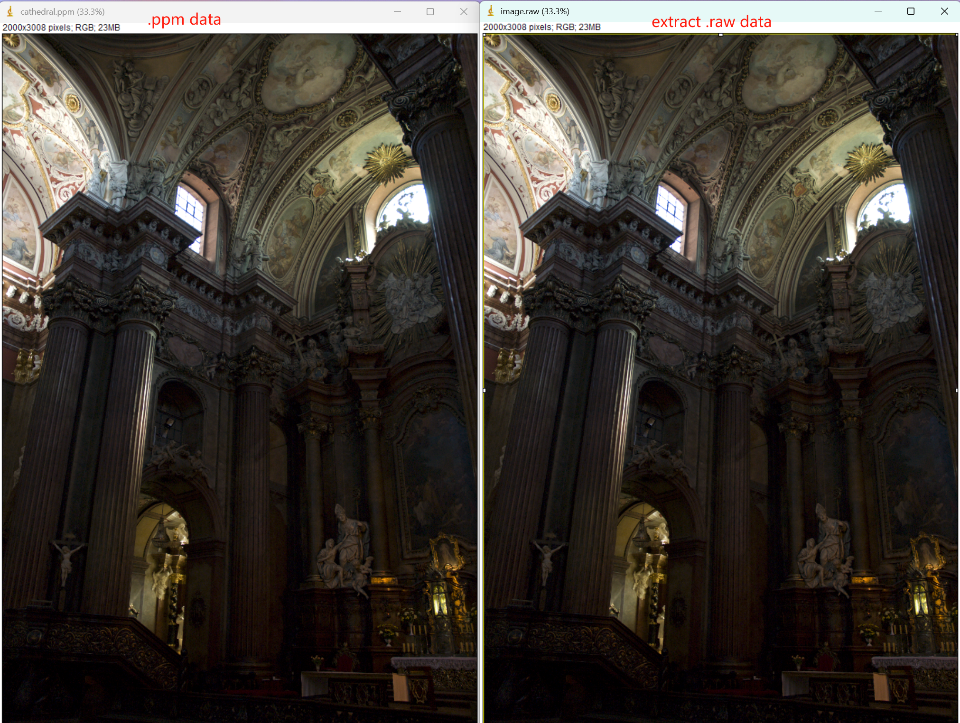
Reading Data
Read .ppm data
Extract .raw data
Reading and Extraction
In the case of cathedral.ppm
Remove the header data.
Keep original binary image data.
Calculating Entropy
In the case of cathedral.ppm
The entropy of the raw binary data is 15.51 bits.

Slide 21
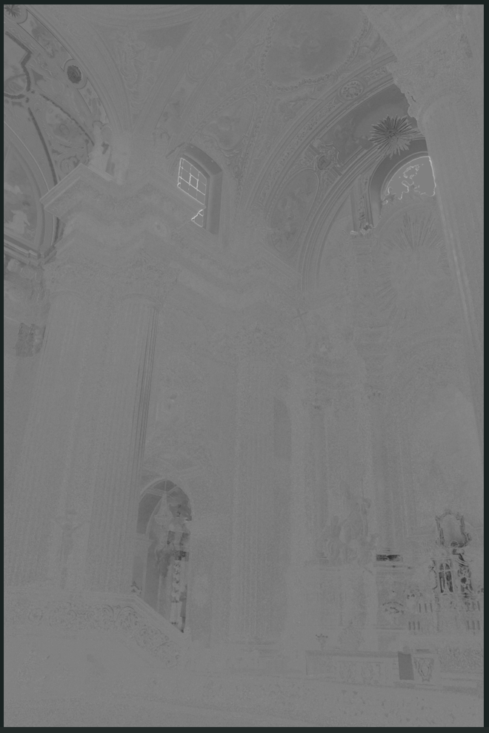

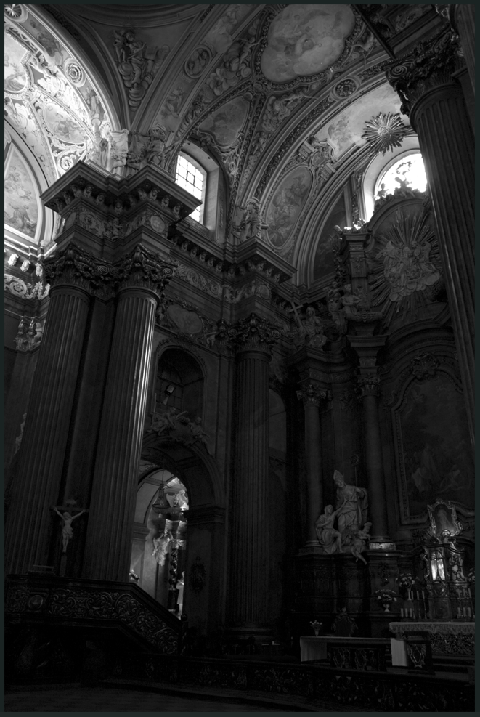
Convert and Quantization
Convert to YCbCr
In the case of cathedral.ppm
Convert to YCbCr, separate luminance (Y) and chrominance (Cb, Cr) channels
FMQM Quantization
In the case of cathedral.ppm
The modulus of Y is 1, and the modulus of Cb and Cr is 10.
After quantization, the entropy of Y is 6.73 bits, Cb is 1.47 bits and Cr is 1.05 bits.
Cb_channel
Cr_channel
Y_channel

Slide 22
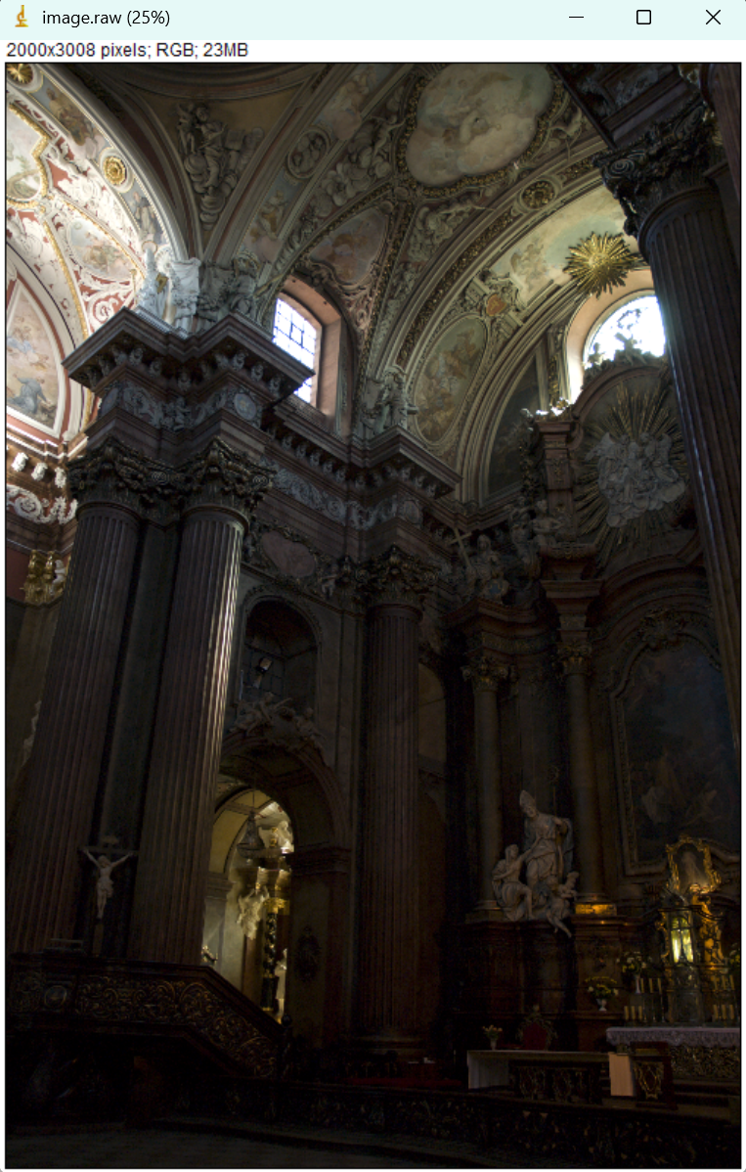
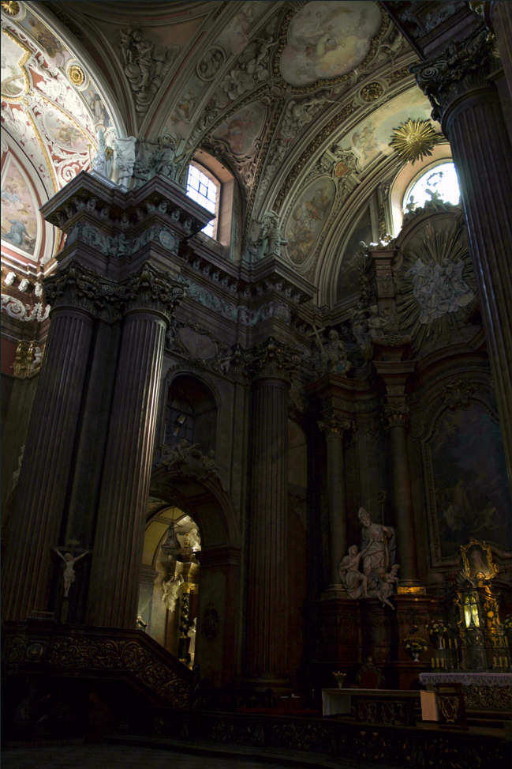
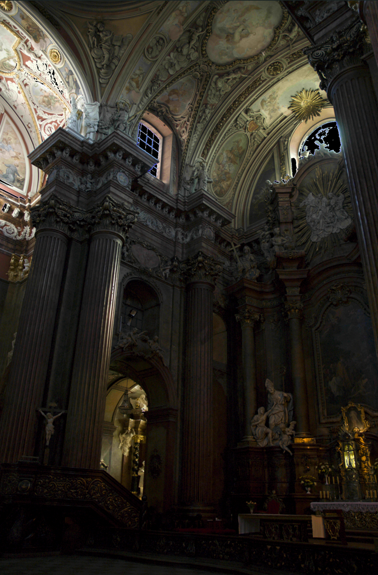
Compression and decompression
Entropy Coding
The modulus of Y is 1, and the modulus of Cb and Cr is 10.
The size of the .raw file before compression is 17625 KB, and the size of the binary file after compression is 8300 KB.
Compression rate: 53%
The modulus of Y is 4, and the modulus of Cb and Cr is 8.
The size of the .raw file before compression is 17625 KB, and the size of the binary file after compression is 6099 KB.
Compression rate: 65%
Restore image
Y: 1, Cb: 10, Cr: 10
PSNR: 31.03 dB
SSIM: 0.975
Restore image
Y: 4, Cb: 8, Cr: 8
PSNR: 31.39 dB
SSIM: 0.955
Raw image

Slide 23
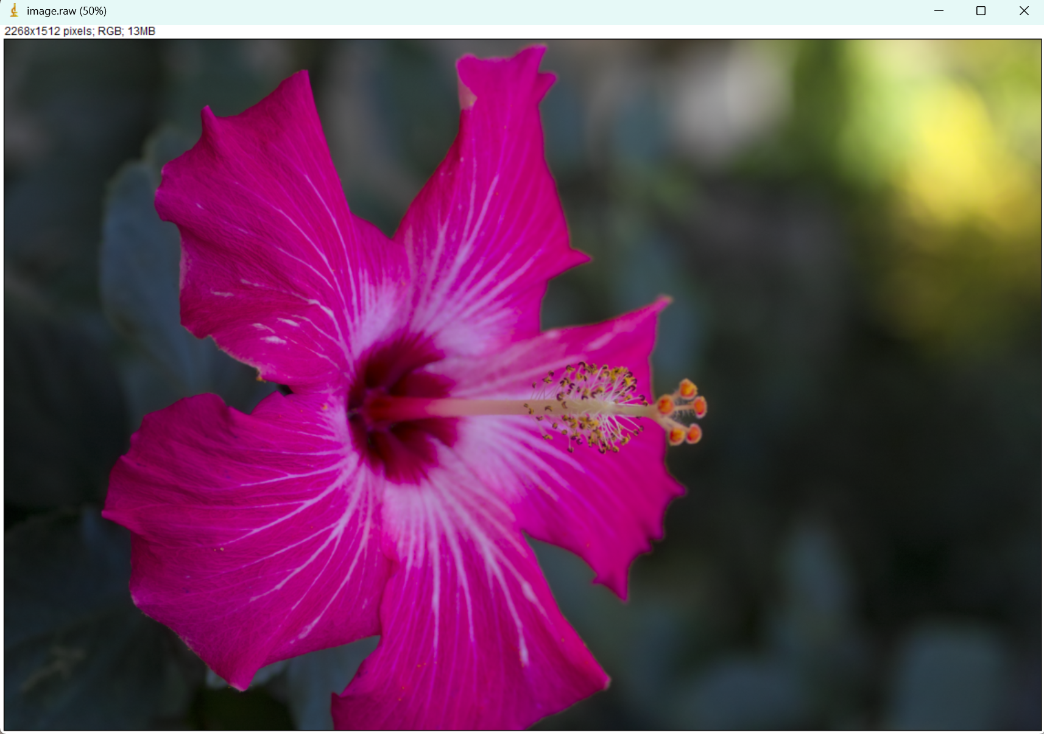


Compression and decompression
Entropy Coding
The modulus of Y is 1, and the modulus of Cb and Cr is 10.
The size of the .raw file before compression is 10047 KB, and the size of the binary file after compression is 3138 KB.
Compression rate: 69%
The modulus of Y is 4, and the modulus of Cb and Cr is 8.
The size of the .raw file before compression is 10047 KB, and the size of the binary file after compression is 1561 KB.
Compression rate: 84%
Raw image
Restore image
Y: 4, Cb: 8, Cr: 8
PSNR: 31.01 dB
SSIM: 0.971
Restore image
Y: 1, Cb: 10, Cr: 10
PSNR: 29.98 dB
SSIM: 0.985

Slide 24
IQA Methods
PSNR
Peak Signal-to-Noise Ratio
Simple and effective: Quickly calculates and compares pixel values to assess the impact of compression on overall image quality.
Standard reference: PSNR above 30 dB typically indicates good image quality with minimal perceptible difference.
Complementarity
PSNR measures global signal differences, while SSIM focuses on local perceptual consistency.
PSNR provides a quick quality estimate, and SSIM assesses detailed structural damage from compression.
PSNR + SSIM combination method give a fuller picture of image quality.
PSNR offers a global benchmark (e.g., 30 dB), while SSIM (e.g., 0.95~0.99) ensures near-lossless visual quality.
SSIM
Structural Similarity Index Measure
Perceptual relevance: Reflects human visual sensitivity to structure, brightness, and contrast for realistic subjective assessment.
Local consistency: Detects local structural loss from compression, addressing PSNR's limitations.

Slide 25
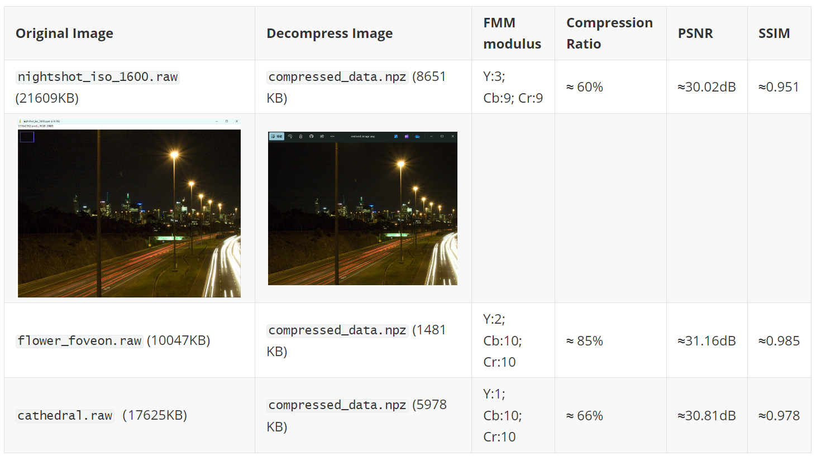
Image Quality Assessment
PSNR
A high PSNR value of >30 dB indicates good image quality, suitable for storage or transmission, and has little effect on the human eye.
It indicate that the adopted FMM+RLE method has achieved a good balance between compression efficiency and image quality.
SSIM
The SSIM ranges from [0, 1]. The closer the value is to 1, the more similar the two images are.
The SSIM range of these compressed images is basically 0.95~0.99.
It means that the images are almost lossless and the quality after compression is very close to the original image.
From the compression results, we can see that we can flexibly adjust the modulus according to the characteristics of the image, the compression rate is almost maintained above 60%, and the human eye perceives the compressed image consistently.

Slide 26
Constraints
Use images with a resolution of ≥ 1920×1080.
The compression ratio must be at least 50%.
Estimated Transmission Time
In the case of flower_foveon.ppm
bandwidth = 10 * 10 ** 6 # 10 Mbps in bits per second transmission_time = (compressed_size * 8) / bandwidth
Estimated Transmission Time: 1.28 seconds
The image transmission time must be ≤ 2 seconds at 10 Mbps bandwidth.
The compressed image must have a PSNR of ≥ 30 dB and a SSIM of ≥ 0.95.
The compressed image transmis-sion bit rate must be ≤ 2 Mbps.
Yes!
The transmission time is less than 2 seconds, which meets the restriction requirement. This indicates that the compressed file size and current network bandwidth can support real-time transmission.

Slide 27

Thanks!
Image Compression for Intelligent Mobile Devices
Zhihan Liu, 1730784

